Slide 1
Introduction to Computer Science (371-1-1601)
Lectures by: Dr. Dan Vilenchik & Dr. Zion Siksik
Recitations by: Ariel Cohen, Moshiko Davidian, Assaf Livne, Yair Mazal

Slide 2
Recitation 7 Object Oriented Programming

Slide 3
Today’s topics
Class definition
Inheritance
implicit constructor
Inheritance vs. memebership

Slide 4
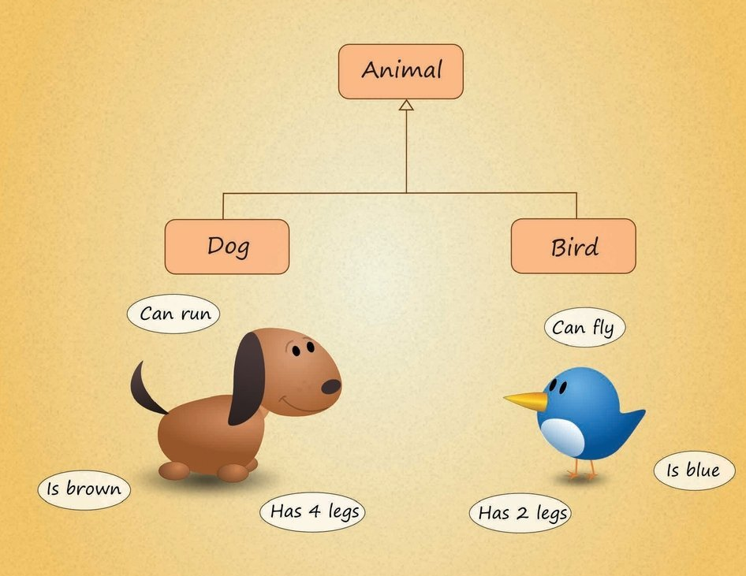
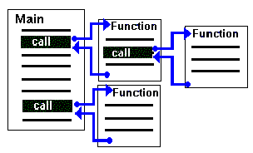
Classes
Procedural Programming
Object-Oriented Programming (OOP)

Slide 5
Object-Oriented Programming (OOP)
An object-oriented program may be viewed as a collection of interacting objects, as opposed to the conventional model, in which a program is seen as a list of tasks (subroutines) to perform. (from Wikipedia)
Objects holds both code (methods) and data (properties) for the entities they represent.

Slide 6
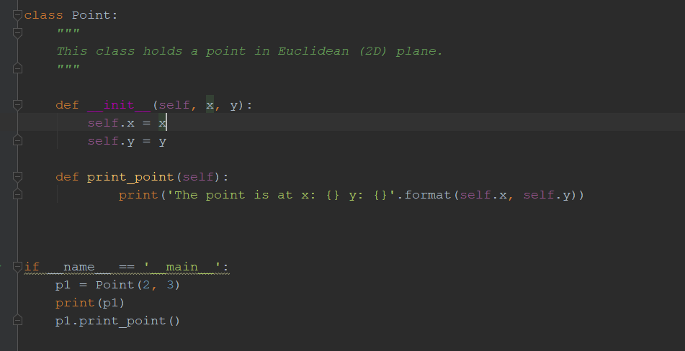
Example – class of Euclidian point

Slide 7
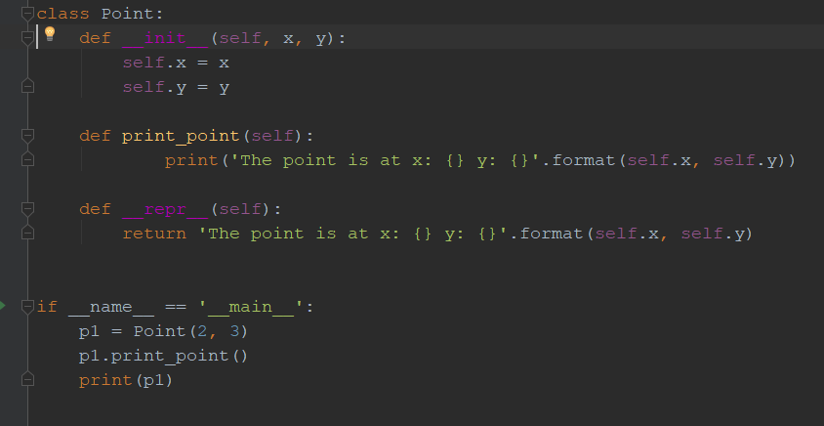
Example – class of Euclidian point

Slide 8
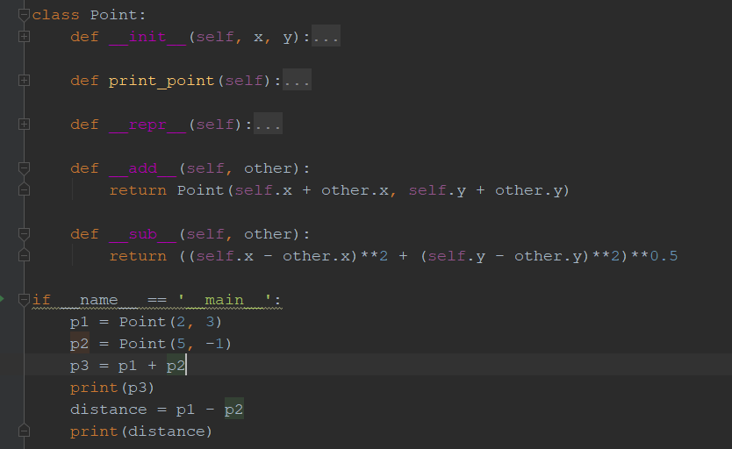
Example – class of Euclidian point

Slide 9
OOP Exercise 1 – class of student
Build a student class that holds the student's name, phone number, grade sheet, and his current courses.
Methods to implement:
Enroll course
Add grade to course
Send email to student
Calculate average grade
Drop course

Slide 10
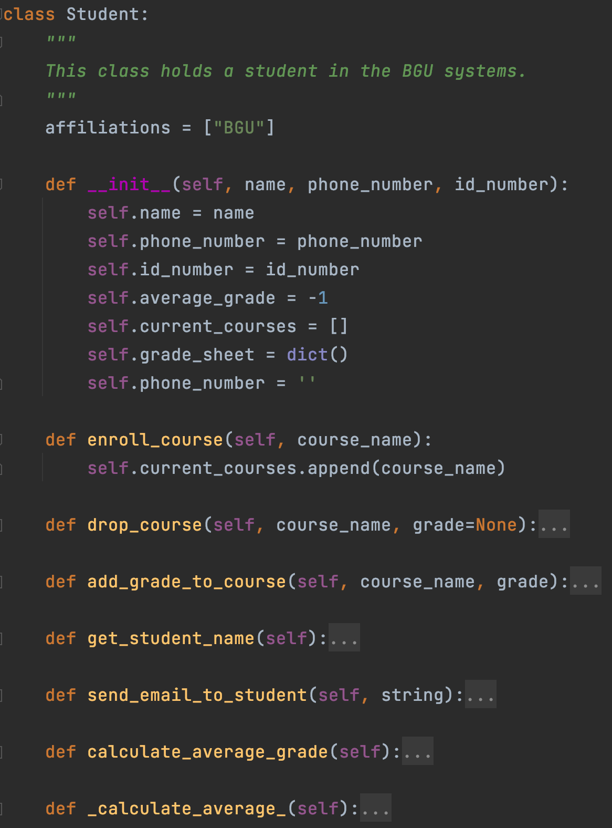
OOP Exercise 1 – class of student
Note that “affiliations” is a member of the class and not the instance (more on that later).
Thus, changing it for one object affects others too for mutable members.

Slide 11
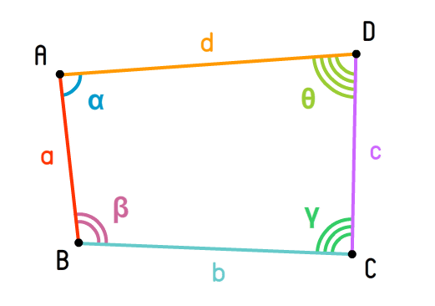
OOP Exercise 2 – quadrangle (מרובע)
Build a class for quadrangles.
Which properties does the quadrangle have?
Which methods should we implement?

Slide 12
OOP Exercise 2 – quadrangle
Properties
Methods
Points
Angles
Edges
Calculate area
Calculate perimeter
Calculate edges from points
Calculate angels from points

Slide 13
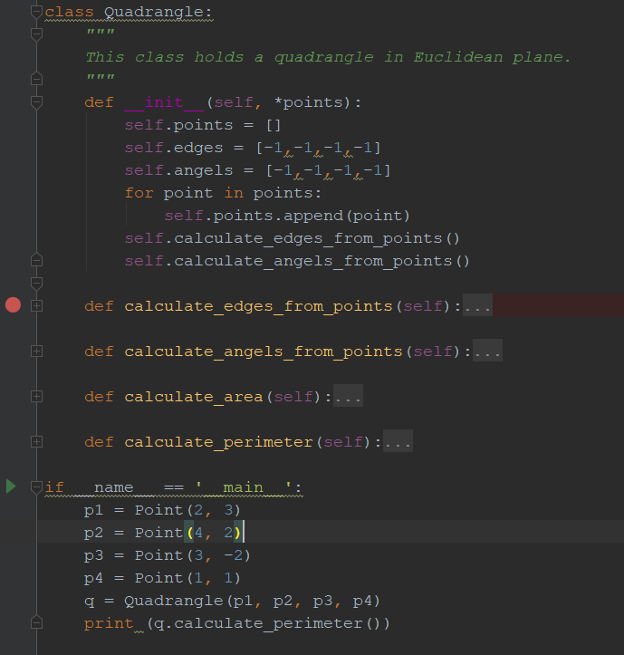
OOP Exercise 2 – quadrangle

Slide 14
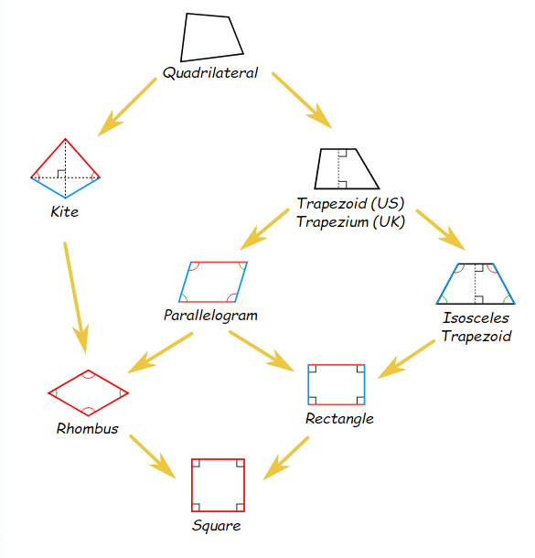
Inheritance
Class can inherit properties or methods from a father class
You can add new properties or methods to the child class
You can also override properties or methods of the father class

Slide 15
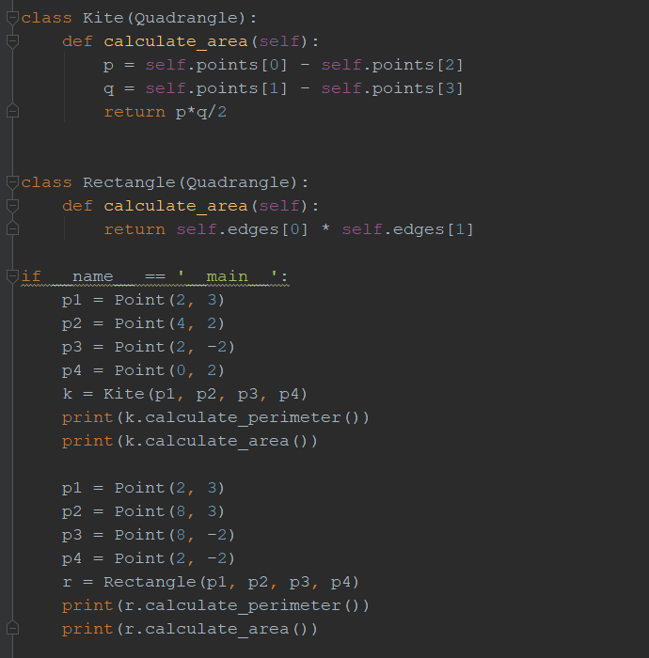
Kite (דלתון) and Rectangle (מלבן)

Slide 16
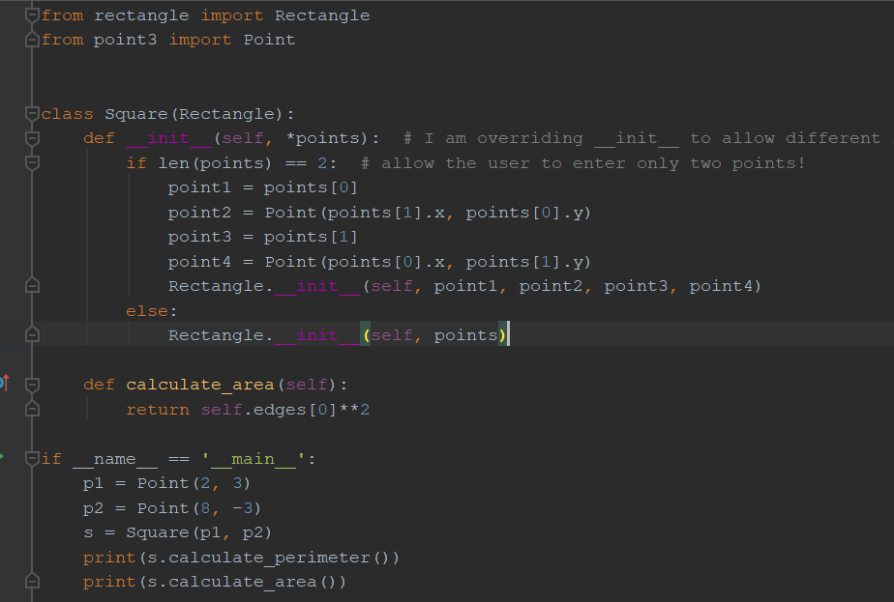
Square

Slide 17
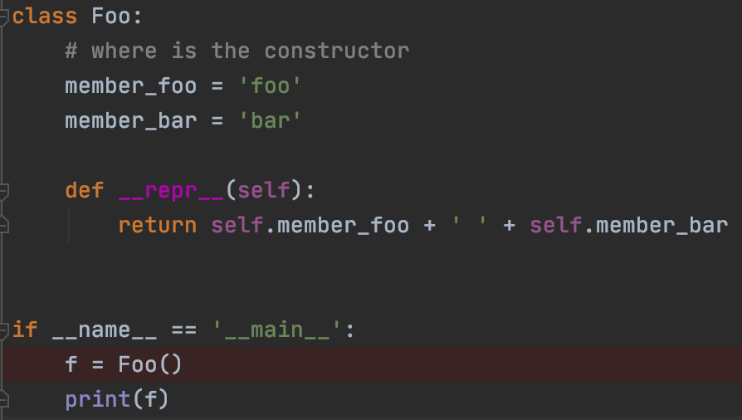
OOP – implicit constructor
Where is the constructor for Foo?
In python, if we don’t declare a constructor explicitly, python declares a defualt one for us.
The defualt constructor:
Allocates the object
Initializes defualt propoerties.

Slide 18

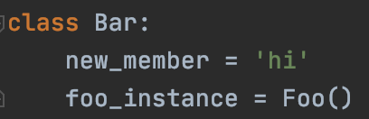

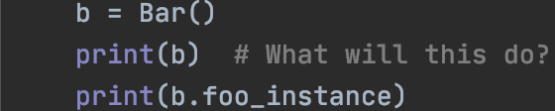
Inheritance vs. memebership
Inheritance
Membership
Subclass has access to parent methds
B is not an instance of Foo, no access to its methods, except via member

Slide 19
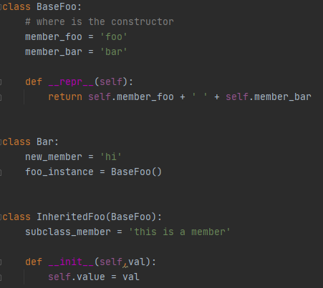
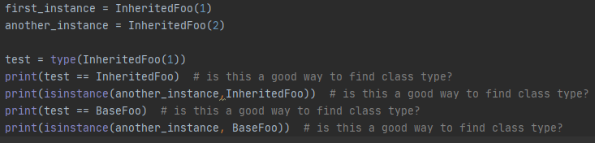
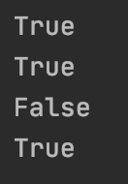
Python classes type testing
How can we check python classes types?
Unlike type() instance() preserves inheritance

Slide 20
OOP exercise - 3
Create a deck of cards class – Deck
The Deck class should have as members cards of type Card (another class).
Each card should have a suit (Hearts, Diamonds, Clubs, Spades) and a value (A,2,3,4,5,6,7,8,9,10,J,Q,K).
The Deck class should have a ”deal” method to deal a single card from the deck. After a card is dealt, it is removed from the deck.
There should be a ”shuffle” method which makes sure the deck of cards has all 52 cards and then rearranges them randomly.

Slide 21
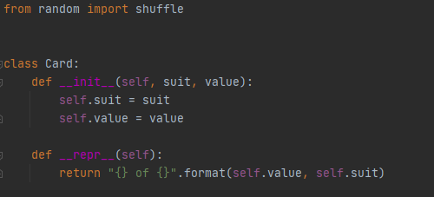
OOP exercise - 3
What is the relationship between the 'card' class and the 'Deck' class?
(Inheritance or memebership?)

Slide 22
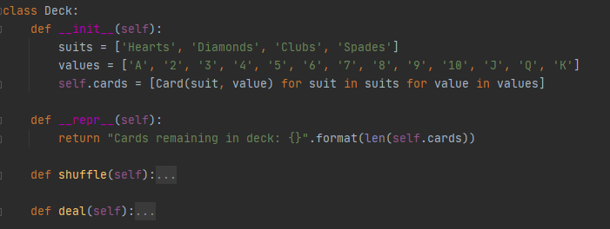
OOP exercise - 3
Memebership!

Slide 23
OOP exercise - 4
Define a Matrix class.
Its constructor should get a list of lists to populate data.
It should have dimension properties.
It should have a transpose method
It should have matrix multiplication method, implemented by overloading the ‘@’ operator.
Matrix multiplication method should verify dimenions and raise an error for incompatible diemnsions.

Slide 24

OOP exercise – 4
super() – refers to base class
Custom exceptions must inherit from Exception class
To avoid changing underlying data, create copies by calling the constructor
Use exceptions
In real life use NumPy ☺

Slide 25
OOP exercise - 5
Define a Vector class.
Implement the dot product

Slide 26
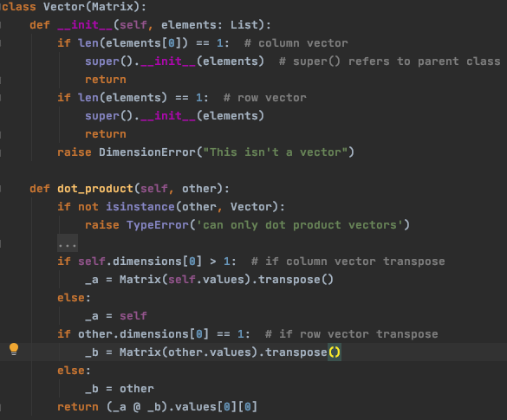
OOP exercise – 5
Inheritance allows for code reuse
Contructor overload can be used with the use of the super() builtin function

Slide 27
Summary
We saw today how to:
OOP
Class definition
Inheritance
implicit constructor
Inheritance vs. memebership

